Slide 1

Intelligence digitalized
Banking Project Implementation of
End to End Datawarehouse
BFSI Datawarehouse

Slide 2
Prerequisite - SDLC - > S/W Dev Life Cycle of Datawarehouse Project
Business Team/Clients -> (Problem -> Requirements)
PM/IT Managers/Data analysts/Data Solution Arch/Business Analysts/Func. Manager/Data Modeler (Req Gathered + Analysis) -> Design (Documents (High Level Design/Low Level Design)/flowcharts /Data flow diagrams / ER Diagrams)
Admin/Platform/Infra team -> Provide the environment (Cluster/Production server & softwares)
Architects/Technical leads/Developers -> Architecture (layers & tools)/Mapping Documents/Development (SQL/Code/ETL (no-code/lowcode))
Testing Team (Developers peer) -> Code review/Testing/Auditing/Data Quality checks
Developers/Devops team/PS team -> Productionization / Implementation/Deployment/Integration
PS team -> Monitoring & Support
Column level - Mapping Documents (low level design)
Source Column | Transformation | Target Column
Location_stg.city | initCap(city) eg. chennai -> Chennai | Location_ods.city
Location_stg.state | upper(substr(state,1,2)) | Location_dim.state
 | eg. Tamilnadu -> TA

Slide 3
Objective & Outcome (Requirement Gathering, Analysis & Design) (Business Team/Business Analyst/Data Solution Architect/Techno Functional Managers/PMO - Scrum Master)

Slide 4
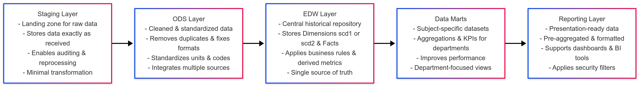
Objective (Business Team/Clients -> (Problem -> Requirement))
Want to Build a scalable enterprise data warehouse that integrates raw data from multiple systems, standardizes it through staging and ODS, applies business rules in the DWH, and delivers trusted insights via Data Marts and Reporting to my consumers.
Banks and financial institutions handle diverse domains: branches, customers, employees, loans, accounts, credit cards, payments, and transactions.
Raw data often arrives from varied sources in different formats with duplication and inconsistency.
The warehouse centralizes and standardizes all entities across layers and ensures a single source of truth, preserving historical and cleansed data.
Data Marts provide department-focused insights with faster query performance and KPIs (Key Performance Indicators eg. Profit/loss) tracking.
Key use cases include branch performance analysis, fraud detection, and customer profiling.
Executives, auditors, Clients, outbound systems, 3rd party systems and managers gain timely, reliable insights for strategic decisions.
Holistic Flow of the DWH Layers (Business Analysts/Data Sol Arch/Techno Functional Managers/Data modeler)

Slide 5
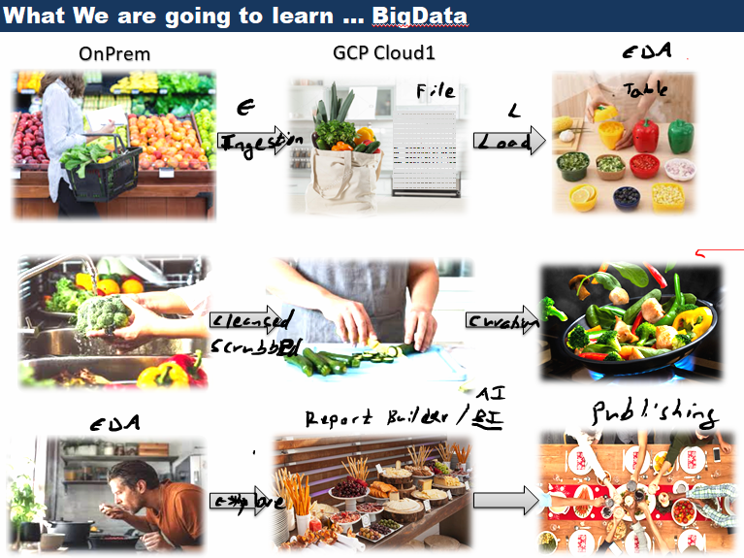
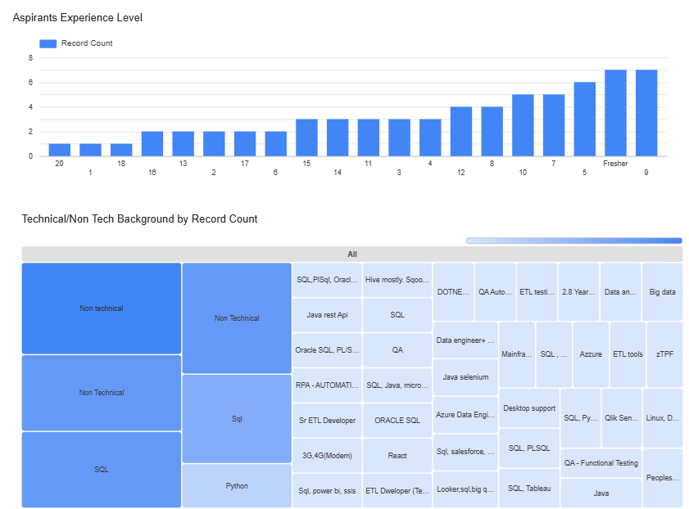
DWH Arch
Architects
Integrated
Datawarehouse (DWH)
OLAP – Non volatile (non modify)
HISTORICAL (TIME VARIANT)
Available
Dis-Integrated
Source
Systems
DataMart
Subject Oriented
Available
Staging
Layer (DSA)
Operation Data
Store (ODS)
Consumption
Layer
Fact Tables
FinMart
Fin_fact
Finance Team
Files
S/SS
Files
S/SS
ODS DB
Dimension Tables
Gov Mart
gov_fact
Officials Team
DBs
Ingestion
Acquisition
Extracts
Inbound
DBs
Cleansing
Scrubbing
Transformation
Business Logic
Joins
Aggr
Biz logic
1,Chennai1,41,100.1
2,chennnai,42,200.2
Banglore,35,400
1,Chennai,41, 100.10
2,Chennai,42,200.70
Banglore
Aggregate/
Summary
Tables
HR Mart
HR
Team
Legacy Sys
1,Chennai,41,100,110,CH
2,Chennai,42,201,220,CH
Raw Data
Table/
Filesystem(Landingpad)
Cleansed/Scrubbed
Tables
Subject Area
Subset of DWH
Transformed
Tables
Reporting
Team
ETL Development (Data Engineers)
Outbound
Team
Banglore,35,400
Data Analysis/Mining

Slide 6
Admin/Platform/Infra team -> Provide the environment (Cluster/Production server & softwares)
Tools/Technologies we are going to use to implement this Project
Design & Model : https://www.mermaidchart.com/ or https://www.mermaidflow.app/ or https://app.diagrams.net/ or word/ppt or erwin/visio
Collaboration / Code Repo/Version control: https://github.com/ or TFS or Gitlab or Bitbucket etc.,
Database/Datawarehouse: MySQL, https://dev.mysql.com/get/Downloads/MySQLGUITools/mysql-workbench-community-8.0.43-winx64.msi
Programming/ETL Code : https://www.python.org/downloads/windows/ or https://www.python.org/downloads/macos/
Python scripts for extraction and loading, SQL for Transformation

Slide 7
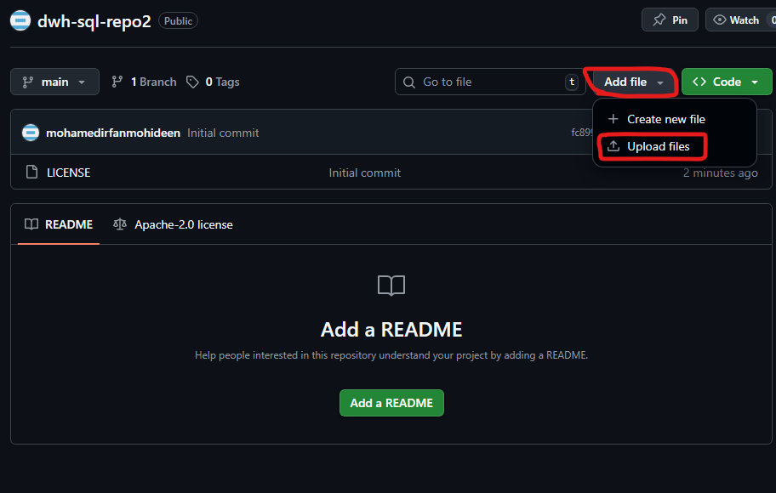
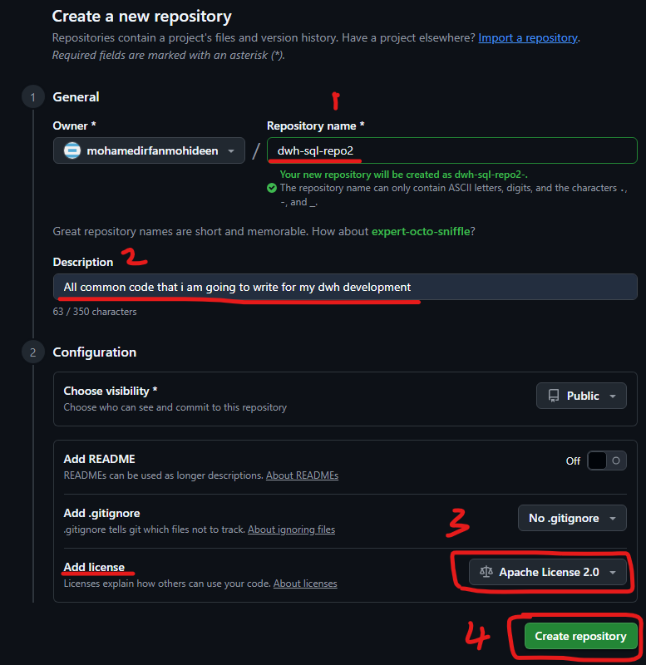
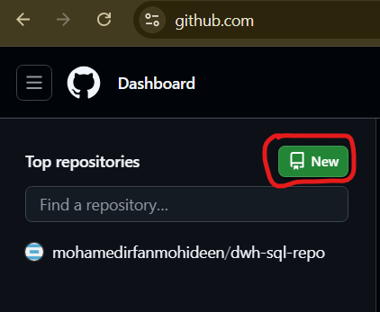
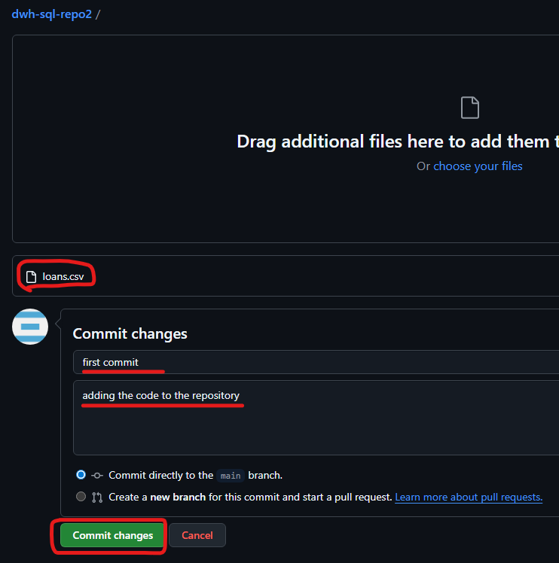
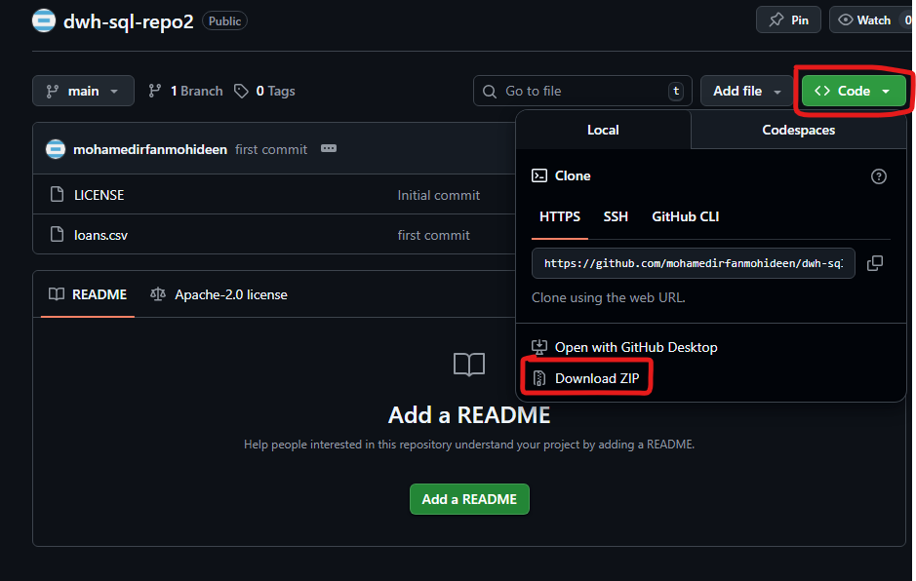
Tasks to our Aspirants:
Task1 (Setting up the code repo and version control system):
Goto https://github.com/
Signup for an account (continue with Google)
Create a repository (choose repository name
, give some description and add license Apache License 2.0)
4. Add your first
5. Commit ur first code
6. Clone (download/pull) your code
1
4
3
2
5
6

Slide 8
Tasks to our Aspirants: Conceptual Data Modelling
Task2 (Working in Mermaid programming):
Goto https://www.mermaidchart.com/
Signup for an account (continue with Google)
Create a New diagram
Paste the below sample flowchart code and see the output of the chart then try with the below complete flowchart
flowchart TD
A[Source Systems] --> B[Staging Layer]
B --> C[ODS Layer]
C --> D[EDW Layer]
D --> E[Data Marts]
E --> F[BI Reports / Dashboards]
---
config:
theme: neo
---
flowchart LR
A[Staging Layer<br/>- Landing zone for raw data<br/>- Stores data exactly as received<br/>- Enables auditing & reprocessing<br/>- Minimal transformation]
-->
B[ODS Layer<br/>- Cleaned & standardized data<br/>- Removes duplicates & fixes formats<br/>- Standardizes units & codes<br/>- Integrates multiple sources]
B -->
C[EDW Layer<br/>- Central historical repository<br/>- Stores Dimensions scd1 or scd2 & Facts<br/>- Applies business rules & derived metrics<br/>- Single source of truth]
C -->
D[Data Marts<br/>- Subject-specific datasets<br/>- Aggregations & KPIs for departments<br/>- Improves performance<br/>- Department-focused views]
D -->
E[Reporting Layer<br/>- Presentation-ready data<br/>- Pre-aggregated & formatted<br/>- Supports dashboards & BI tools<br/>- Applies security filters]

Slide 9
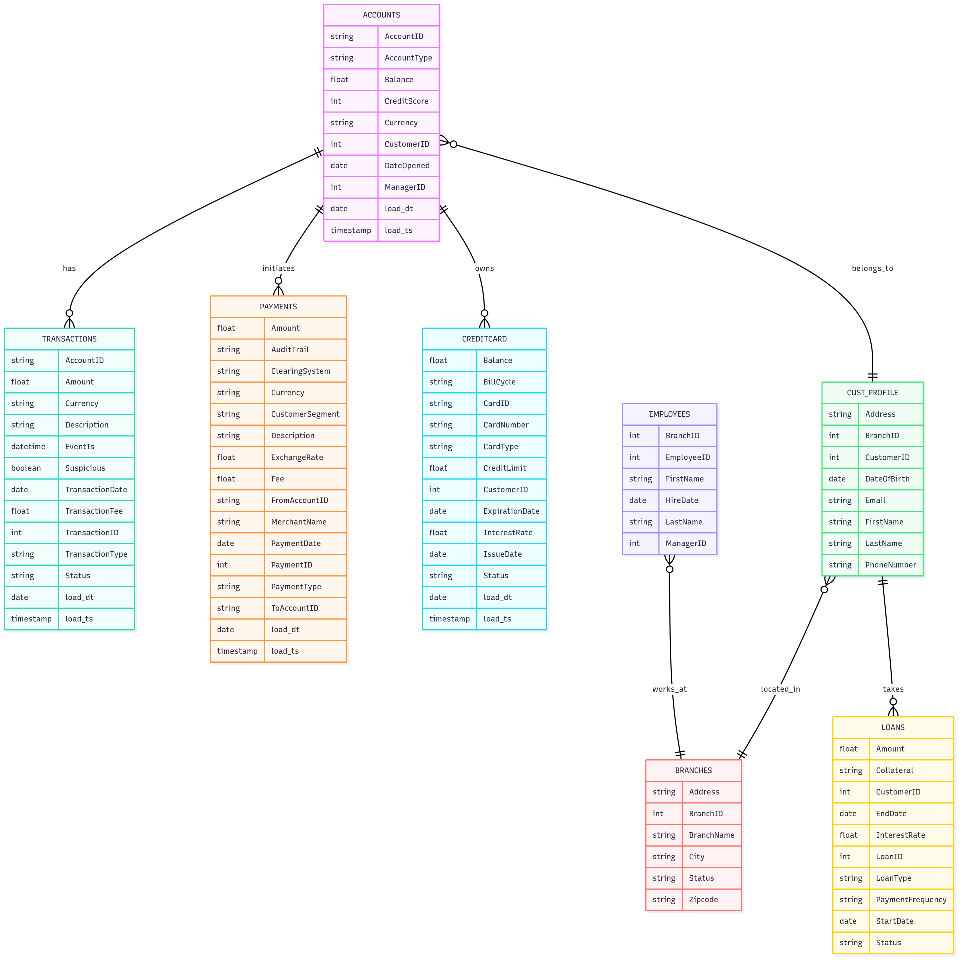
Tasks to our Aspirants:
Logical Data Model – ER Diagram
Task3 (Working in Mermaid programming):
Create a New diagram
Paste the below sample erDiagram code and see the output of the chart then try with the below complete ER
erDiagram
Entity1 ||--o{ Entity2 : "relation name"
User ||--|| SSN : "One to One"
User ||--o{ Orders : " One to Zero/Many "
Orders }o--|| User : " Zero/Many to One "
Users }o--o{ Products : " Zero/Many to Zero/Many "
Users }|--|{ Products : " One/Many to One/Many "
erDiagram
ACCOUNTS {
string AccountID
string AccountType
float Balance
int CreditScore
string Currency
int CustomerID
date DateOpened
int ManagerID
date load_dt
timestamp load_ts
}
TRANSACTIONS {
string AccountID
float Amount
string Currency
string Description
datetime EventTs
boolean Suspicious
date TransactionDate
float TransactionFee
int TransactionID
string TransactionType
string Status
date load_dt
timestamp load_ts
}
PAYMENTS {
float Amount
string AuditTrail
string ClearingSystem
string Currency
string CustomerSegment
string Description
float ExchangeRate
float Fee
string FromAccountID
string MerchantName
date PaymentDate
int PaymentID
string PaymentType
string ToAccountID
date load_dt
timestamp load_ts
}
CREDITCARD {
float Balance
string BillCycle
string CardID
string CardNumber
string CardType
float CreditLimit
int CustomerID
date ExpirationDate
float InterestRate
date IssueDate
string Status
date load_dt
timestamp load_ts
}
CUST_PROFILE {
string Address
int BranchID
int CustomerID
date DateOfBirth
string Email
string FirstName
string LastName
string PhoneNumber
}
EMPLOYEES {
int BranchID
int EmployeeID
string FirstName
date HireDate
string LastName
int ManagerID
}
BRANCHES {
string Address
int BranchID
string BranchName
string City
string Status
string Zipcode
}
LOANS {
float Amount
string Collateral
int CustomerID
date EndDate
float InterestRate
int LoanID
string LoanType
string PaymentFrequency
date StartDate
string Status
}
%% Relationships
ACCOUNTS ||--o{ TRANSACTIONS : has
ACCOUNTS ||--o{ PAYMENTS : initiates
ACCOUNTS ||--o{ CREDITCARD : owns
ACCOUNTS }o--|| CUST_PROFILE : belongs_to
EMPLOYEES }o--|| BRANCHES : works_at
CUST_PROFILE }o--|| BRANCHES : located_in
CUST_PROFILE ||--o{ LOANS : takes

Slide 10
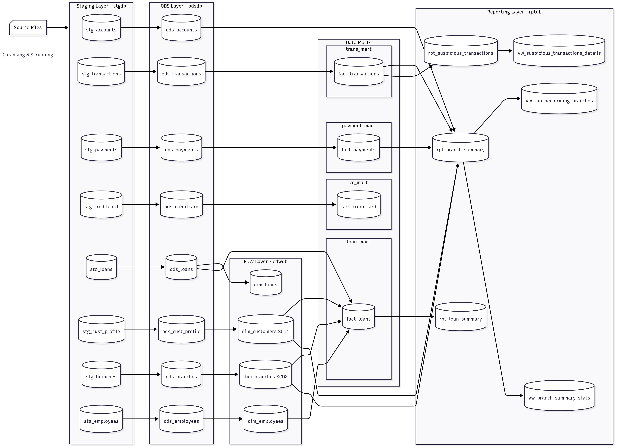
Tasks to our Aspirants: Task4 (Working in Mermaid programming):
Physical Data Model (Step1) - Data Flow Diagram (DFD)
---
config:
theme: mc
look: neo
---
flowchart LR
subgraph STG["Staging Layer - stgdb"]
stg_accounts[("stg_accounts")]
stg_transactions[("stg_transactions")]
stg_payments[("stg_payments")]
stg_creditcard[("stg_creditcard")]
stg_loans[("stg_loans")]
stg_cust_profile[("stg_cust_profile")]
stg_branches[("stg_branches")]
stg_employees[("stg_employees")]
end
subgraph ODS["ODS Layer - odsdb"]
ods_accounts[("ods_accounts")]
ods_transactions[("ods_transactions")]
ods_payments[("ods_payments")]
ods_creditcard[("ods_creditcard")]
ods_loans[("ods_loans")]
ods_cust_profile[("ods_cust_profile")]
ods_branches[("ods_branches")]
ods_employees[("ods_employees")]
end
subgraph EDW["EDW Layer - edwdb"]
dim_customers[("dim_customers SCD1")]
dim_branches[("dim_branches SCD2")]
dim_employees[("dim_employees")]
dim_loans[("dim_loans")]
end
subgraph trans_mart["trans_mart"]
fact_transactions[("fact_transactions")]
end
subgraph payment_mart["payment_mart"]
fact_payments[("fact_payments")]
end
subgraph cc_mart["cc_mart"]
fact_creditcard[("fact_creditcard")]
end
subgraph loan_mart["loan_mart"]
fact_loans[("fact_loans")]
end
subgraph MARTS["Data Marts"]
trans_mart
payment_mart
cc_mart
loan_mart
end
subgraph REPORT["Reporting Layer - rptdb"]
rpt_branch_summary[("rpt_branch_summary")]
vw_top_performing[("vw_top_performing_branches")]
rpt_suspicious_txn[("rpt_suspicious_transactions")]
vw_branch_stats[("vw_branch_summary_stats")]
vw_suspicious_details[("vw_suspicious_transactions_details")]
rpt_loan_summary[("rpt_loan_summary")]
end
stg_accounts --> ods_accounts
stg_transactions --> ods_transactions
stg_payments --> ods_payments
stg_creditcard --> ods_creditcard
stg_loans --> ods_loans
stg_cust_profile --> ods_cust_profile
stg_branches --> ods_branches
stg_employees --> ods_employees
ods_cust_profile --> dim_customers
ods_branches --> dim_branches
ods_employees --> dim_employees
ods_loans --> dim_loans
ods_transactions --> fact_transactions
ods_payments --> fact_payments
ods_creditcard --> fact_creditcard
ods_loans --> fact_loans
dim_branches --> fact_loans
dim_customers --> fact_loans
dim_employees --> fact_loans
dim_branches --> rpt_branch_summary
dim_customers --> rpt_branch_summary
ods_accounts --> rpt_branch_summary
fact_payments --> rpt_branch_summary
fact_transactions --> rpt_branch_summary & rpt_suspicious_txn
fact_loans --> rpt_loan_summary
rpt_branch_summary --> vw_top_performing & vw_branch_stats
rpt_suspicious_txn --> vw_suspicious_details
n1["Source Files"]
n1@{ shape: card }
style n1 color:#000000

Slide 11
Business Analysts/Data Sol Arch/Techno Functional Managers/Data modelers
Technical Outcome
A unified/Converged/Consolidated, multi-layered data warehouse that integrates batch raw data into a structured, historical, and business-ready repository with support for both granular (low level - age) and aggregated (high level – avg of age) analytics.
Business Outcome
Branch Performance: Quick identification of top-performing and underperforming branches.
Fraud & Risk Detection: Automated detection of suspicious transactions through specialized marts.
Customer Insights: Enhanced customer profiling for better services and up/cross-selling.
Operational Efficiency: Removal of duplicate/inconsistent data, enabling faster reporting.
Data-Driven Decision Making: Trusted reports and dashboards empowering leadership decisions.

Slide 12
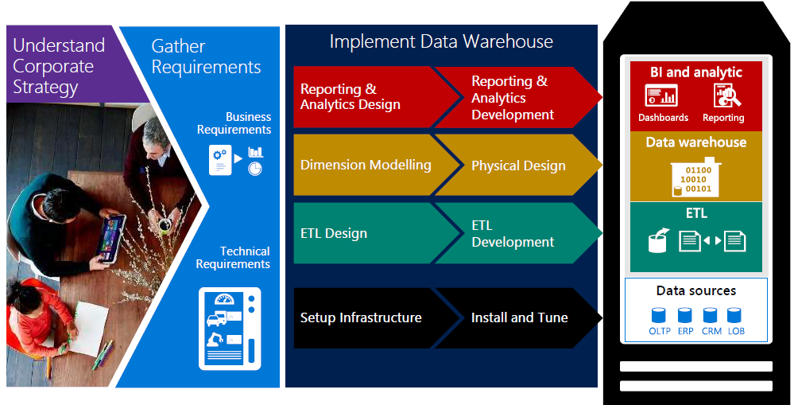
End to End Lifecycle of this project - Design & Dev ( Business Team/Architects/Modelers/Developers/Platform/Reporting/PS/Test)
ETL – Extract Transform Load

Slide 13
Data Modeling (Source System Analysis & Modeling) Data Modeler/Stewards & Data Solution Architect
PM/IT Managers/Data analysts/Data Solution Arch/Business Analysts/Func. Manager/Data Modeler
(Req Gathered + Analysis) -> Design (Documents (High Level Design/Low Level Design)/flowcharts/Data flow diagrams)

Slide 14
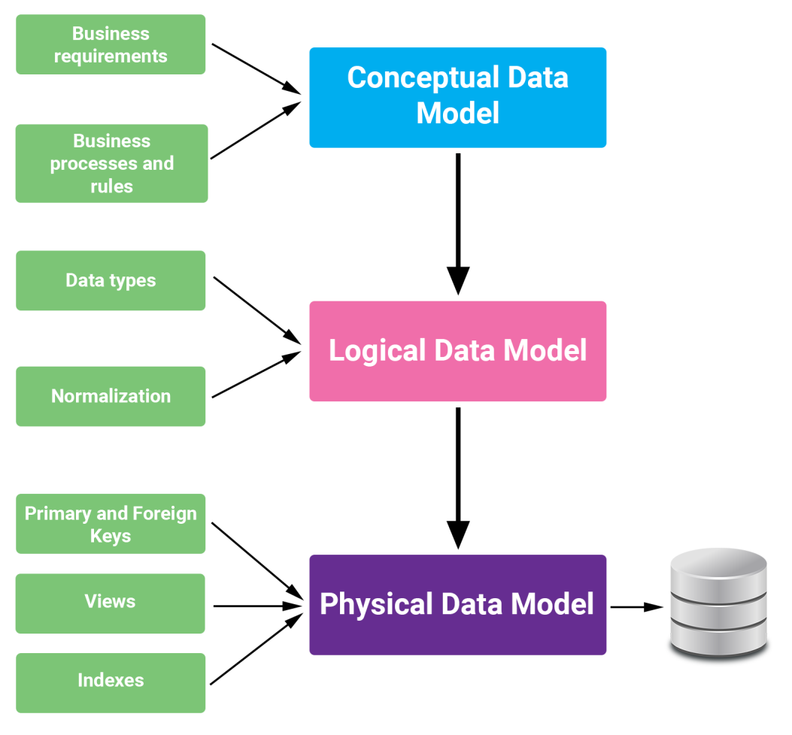
Data Modeling
Dwh highlevel layers
Entity relationship diagrams
1. Dfd – data flow diagrams (step1)
2. Ddls (data definition language) (step2)

Slide 15
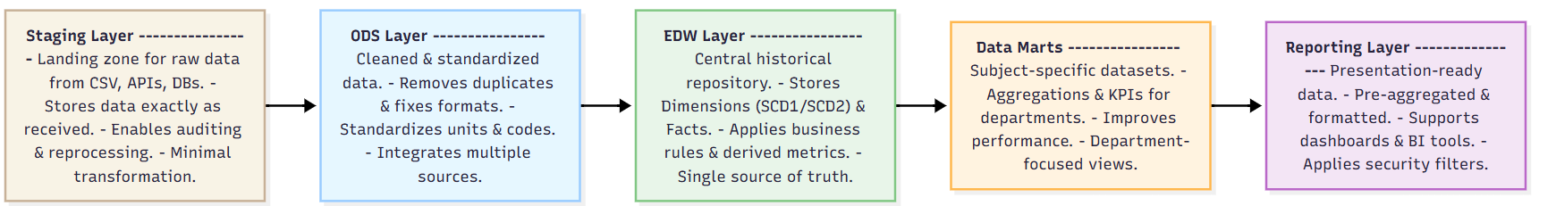
Datawarehouse Layers (high level)
flowchart LR
A[Staging Layer<br/>- Landing zone for raw data<br/>- Stores data exactly as received<br/>- Enables auditing & reprocessing<br/>- Minimal transformation]
-->
B[ODS Layer<br/>- Cleaned & standardized data<br/>- Removes duplicates & fixes formats<br/>- Standardizes units & codes<br/>- Integrates multiple sources]
B -->
C[EDW Layer<br/>- Central historical repository<br/>- Stores Dimensions scd1 or scd2 & Facts<br/>- Applies business rules & derived metrics<br/>- Single source of truth]
C -->
D[Data Marts<br/>- Subject-specific datasets<br/>- Aggregations & KPIs for departments<br/>- Improves performance<br/>- Department-focused views]
D -->
E[Reporting Layer<br/>- Presentation-ready data<br/>- Pre-aggregated & formatted<br/>- Supports dashboards & BI tools<br/>- Applies security filters]
Mermaid – Flowchart ()
flowchart TD
A[Source Systems] --> B[Staging Layer]
B --> C[ODS Layer]
C --> D[EDW Layer]
D --> E[Data Marts]
E --> F[BI Reports / Dashboards]

Slide 16
Conceptual Data Model
Source System Analysis
Branch – Represents banking branches.
Customer – Represents individuals or organizations with accounts/loans/cards.
Employee – Staff working in branches.
Account – Customer’s bank accounts (savings, current, etc.).
Loan – Loan products taken by customers.
Credit Card – Credit card issued to customers.
Payment – Payments made through cards, loans, or accounts.
Transaction – All monetary activities (deposits, withdrawals, transfers, purchases).
Business Requirements & relational rules (high level)
Branch – Employee: Each branch employs many employees.
Branch – Customer: Customers are associated with a branches.
Customer – Account: A customer can have multiple accounts; each account belongs to one customer.
Customer – Loan: One customer can take Zero/One/Many loans.
Customer – Credit Card: A customer can hold multiple credit cards.
Account – Transaction: Each account has many transactions.
Credit Card – Payment: Payments are linked to a credit card.
Loan – Payment: Multiple Payments can also be linked to Multiple loans.

Slide 17
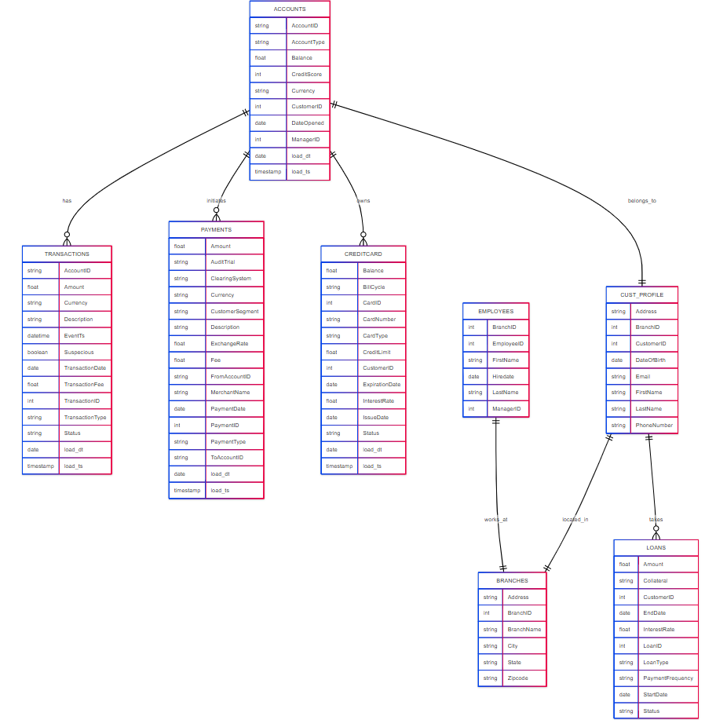
Logical Data model - ER Diagram
erDiagram
father {int fid
string name
string occupation }
daughters {int did
int fid
string name
string studies}
father||--o{ daughters :"can have"
father||--o{ sons :"can have"
sons||--o{ school :"studying"
erDiagram
Entity1 ||--o{ Entity2 : "relation name"
User ||--|| SSN : "One to One"
User ||--|{ Orders : " One to Zero/Many "
Orders }o--|| User : " Zero/Many to One "
Users }o--o{ Products : " Zero/Many to Zero/Many "
Users }|--|{ Products : " One/Many to One/Many "
erDiagram
ACCOUNTS {
string AccountID
string AccountType
float Balance
int CreditScore
string Currency
int CustomerID
date DateOpened
int ManagerID
date load_dt
timestamp load_ts
}
TRANSACTIONS {
string AccountID
float Amount
string Currency
string Description
datetime EventTs
boolean Suspicious
date TransactionDate
float TransactionFee
int TransactionID
string TransactionType
string Status
date load_dt
timestamp load_ts
}
PAYMENTS {
float Amount
string AuditTrail
string ClearingSystem
string Currency
string CustomerSegment
string Description
float ExchangeRate
float Fee
string FromAccountID
string MerchantName
date PaymentDate
int PaymentID
string PaymentType
string ToAccountID
date load_dt
timestamp load_ts
}
CREDITCARD {
float Balance
string BillCycle
string CardID
string CardNumber
string CardType
float CreditLimit
int CustomerID
date ExpirationDate
float InterestRate
date IssueDate
string Status
date load_dt
timestamp load_ts
}
CUST_PROFILE {
string Address
int BranchID
int CustomerID
date DateOfBirth
string Email
string FirstName
string LastName
string PhoneNumber
}
EMPLOYEES {
int BranchID
int EmployeeID
string FirstName
date HireDate
string LastName
int ManagerID
}
BRANCHES {
string Address
int BranchID
string BranchName
string City
string Status
string Zipcode
}
LOANS {
float Amount
string Collateral
int CustomerID
date EndDate
float InterestRate
int LoanID
string LoanType
string PaymentFrequency
date StartDate
string Status
}
%% Relationships
ACCOUNTS ||--o{ TRANSACTIONS : "connected using Account_id"
ACCOUNTS ||--o{ PAYMENTS : initiates
ACCOUNTS ||--o{ CREDITCARD : owns
ACCOUNTS }o--|| CUST_PROFILE : belongs_to
EMPLOYEES }o--|| BRANCHES : works_at
CUST_PROFILE }o--|| BRANCHES : located_in
CUST_PROFILE ||--o{ LOANS : takes
erDiagram
CUST ||--o{ TRANS : "makes"
CUST ||--o{ LOAN : "takes"
CUST {
int custid PK "Primary key"
string name
int age
}
TRANS {
int txnid PK "Primary key"
int custid FK "Foreign key to CUST"
int qty
float amt
}
LOAN {
float amount
string collateral
int customerid FK "Foreign key to CUST"
date startdate
date enddate
float interestRate
float loanid PK "Primary key"
string loanType
string paymentFrequency
string status
}
erDiagram
%%Entities - customer, creditcard
customer {int cid
string name
string addr}
creditcard {int ccid
int cid
varchar(200) type
bigint limit}
branches {int bid
int cid
string brname
string addr}
%%string - datatype
%%cid - attribute/columns
%%relation - ||--||, ||--|{, }o--o{, }|--|{, ||--o|
customer ||--o{creditcard:"can hold"
customer }|--||branches:"mapped to"

Slide 18
ETL Design & Implementation (DWH Implementation, DFD, Physical Data model) ETL Developer, DWH Developer, Lead, Architect, DB/DWH Admin, Platform team

Slide 19
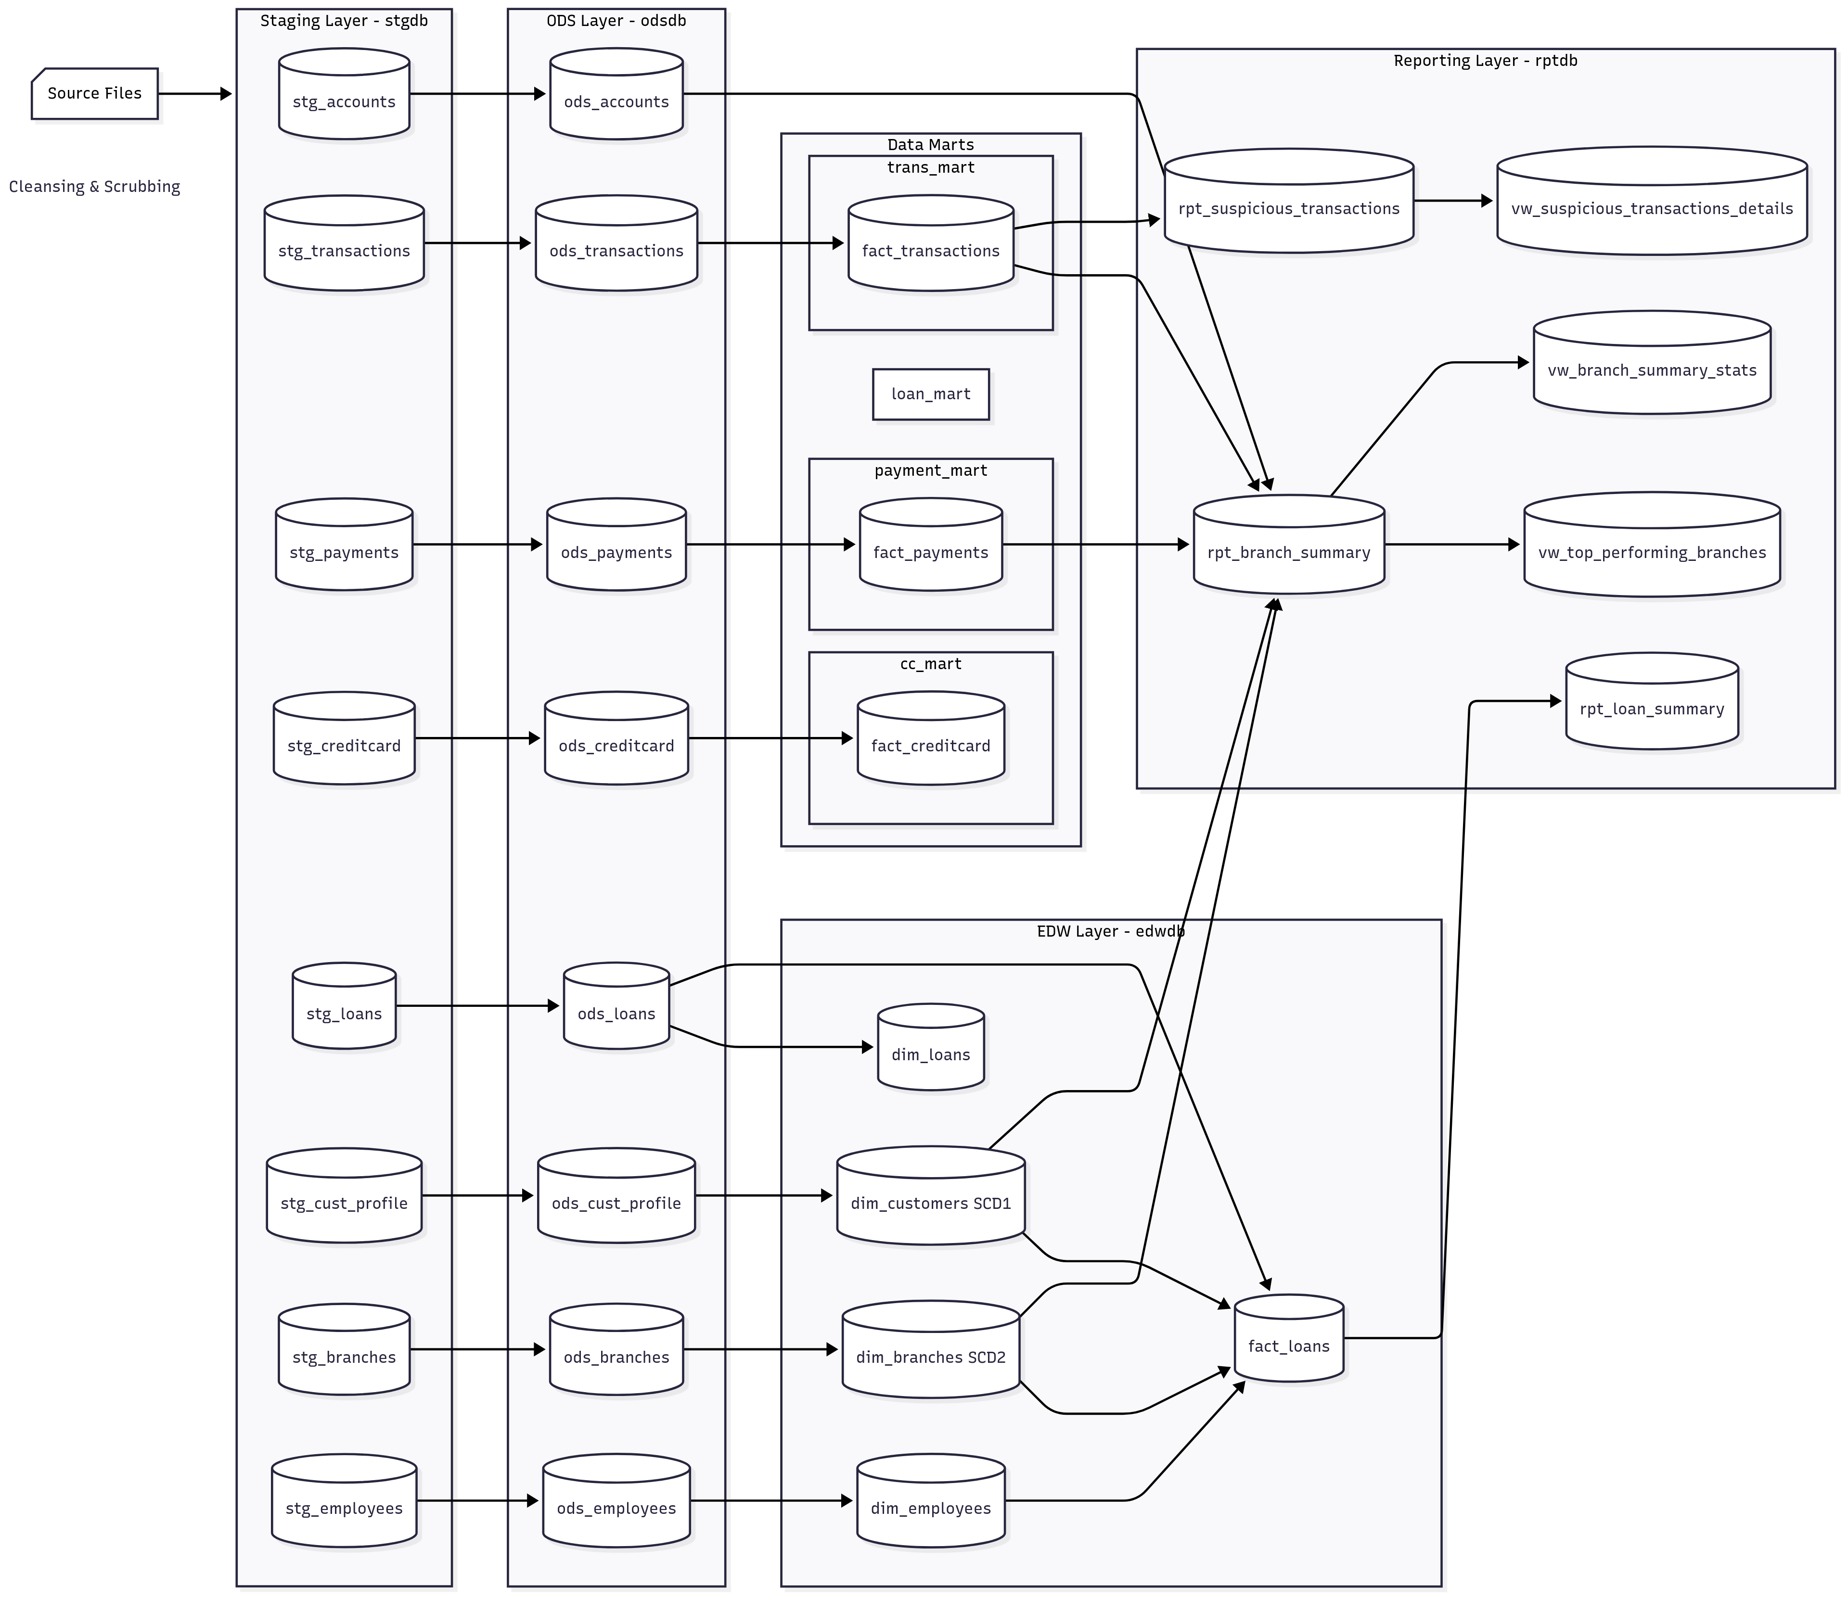
Physical Data Model (Step1) – Data modeler
Data Flow Diagram (DFD)
---
config:
layout: dagre
---
flowchart LR
subgraph STG["Staging Layer - stgdb"]
stg_accounts[("stg_accounts")]
stg_transactions[("stg_transactions")]
stg_payments[("stg_payments")]
stg_creditcard[("stg_creditcard")]
stg_loans[("stg_loans")]
stg_cust_profile[("stg_cust_profile")]
stg_branches[("stg_branches")]
stg_employees[("stg_employees")]
end
subgraph ODS["ODS Layer - odsdb"]
ods_accounts[("ods_accounts")]
ods_transactions[("ods_transactions")]
ods_payments[("ods_payments")]
ods_creditcard[("ods_creditcard")]
ods_loans[("ods_loans")]
ods_cust_profile[("ods_cust_profile")]
ods_branches[("ods_branches")]
ods_employees[("ods_employees")]
end
subgraph EDW["EDW Layer - edwdb"]
dim_customers[("dim_customers SCD1")]
dim_branches[("dim_branches SCD2")]
dim_employees[("dim_employees")]
dim_loans[("dim_loans")]
fact_loans[("fact_loans")]
end
subgraph trans_mart["trans_mart"]
fact_transactions[("fact_transactions")]
end
subgraph payment_mart["payment_mart"]
fact_payments[("fact_payments")]
end
subgraph cc_mart["cc_mart"]
fact_creditcard[("fact_creditcard")]
end
subgraph MARTS["Data Marts"]
trans_mart
payment_mart
cc_mart
loan_mart
end
subgraph REPORT["Reporting Layer - rptdb"]
rpt_branch_summary[("rpt_branch_summary")]
vw_top_performing[("vw_top_performing_branches")]
rpt_suspicious_txn[("rpt_suspicious_transactions")]
vw_branch_stats[("vw_branch_summary_stats")]
vw_suspicious_details[("vw_suspicious_transactions_details")]
rpt_loan_summary[("rpt_loan_summary")]
end
stg_accounts --> ods_accounts
stg_transactions --> ods_transactions
stg_payments --> ods_payments
stg_creditcard --> ods_creditcard
stg_loans --> ods_loans
stg_cust_profile --> ods_cust_profile
stg_branches --> ods_branches
stg_employees --> ods_employees
ods_cust_profile --> dim_customers
ods_branches --> dim_branches
ods_employees --> dim_employees
ods_loans --> dim_loans & fact_loans
ods_transactions --> fact_transactions
ods_payments --> fact_payments
ods_creditcard --> fact_creditcard
dim_branches --> fact_loans & rpt_branch_summary
dim_customers --> fact_loans & rpt_branch_summary
dim_employees --> fact_loans
ods_accounts --> rpt_branch_summary
fact_payments --> rpt_branch_summary
fact_transactions --> rpt_branch_summary & rpt_suspicious_txn
fact_loans --> rpt_loan_summary
rpt_branch_summary --> vw_top_performing & vw_branch_stats
rpt_suspicious_txn --> vw_suspicious_details
n1["Source Files"] --> STG
n2["Cleansing &amp; Scrubbing"]
n1@{ shape: card}
n2@{ shape: text}
style n1 color:#000000

Slide 20
Physical Data Model (Step2)
Infrastructure setup (admin), Developers (software & client setup)
Server – Platform team
US Ohio
34.63.107.222
Mysql DWH
request
SQL
SQL
34.63.107.222
we47usr
We47@123
Python
Response - Table
Client
Client
Client
Girish (US)
SQL – Workbench
Python
Irfan(Chn)
SQL – Workbench
Python
Divya (Delhi)
Mysql Workbench
files

Slide 21
Infra & Platform Setup (Form a Datawarehouse, Provide Python programming environment) DB/DWH Admin, Platform team

Slide 22
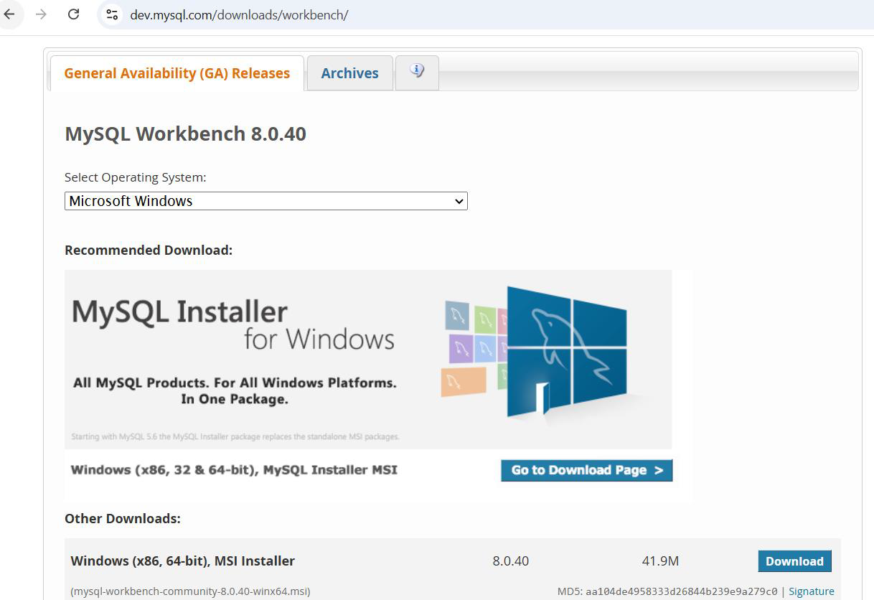
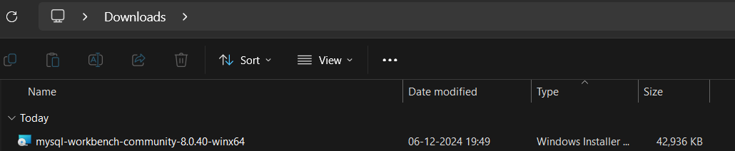
Tasks to our Aspirants:
Task5 (Configuring SQL Workbench):
Download the mysql workbench software into your Windows/MAC PC
https://dev.mysql.com/downloads/workbench/
2. Install the software in your PC

Slide 23
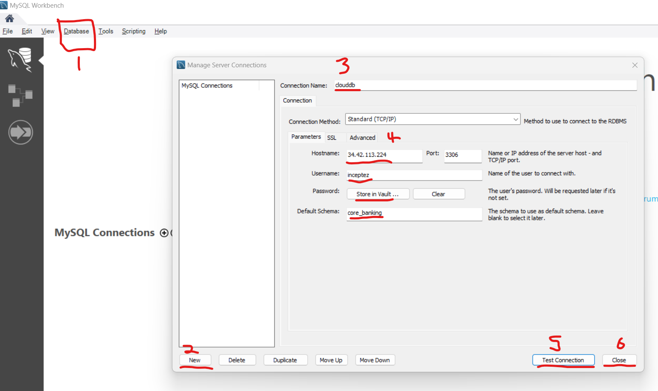
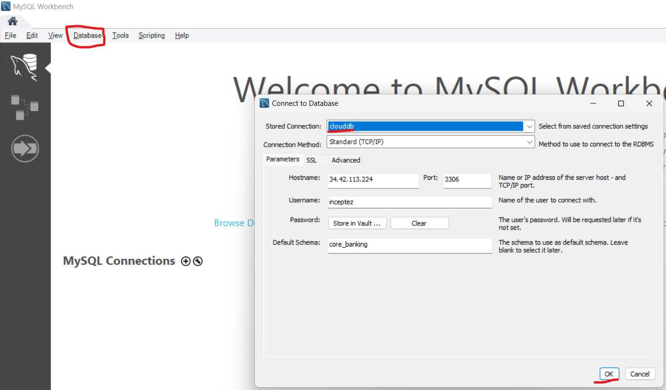
Tasks to our Aspirants:
Task5 (Configuring SQL Workbench):
3. Open the Software
Database -> New
Connection Name : clouddb
Hostname : 34.63.107.222
Username : testusr
Password (store in valut) : Inceptez@123
Default Schema :
Test Connection -> Close
4. Database -> Connect to Database -> Ok
5. Become a Data Analyst/SQL writing queries

Slide 24
Tasks to our Aspirants: (Done by Admin/Developers)
Task6 (Configuring Python):
Install Python in your command prompt (Windows) / terminal (Mac)
In Windows -> open command prompt -> Run the below installation command and then start python
a. goto https://www.python.org/downloads/windows/
b. Download the software Download Windows installer (64-bit)
c. Run the installer python-3.13.7-amd64
d. Goto search -> type cmd -> run the below commands
python -m pip install pandas
python -m pip install sqlalchemy
python -m pip install pymysql
e. Run python in the command prompt
python

Slide 25
Architects/Technical leads/Developers -> Architecture/Mapping Documents/Development (SQL/Code/ETL (no-code/lowcode))
Developers/Devops team/PS team -> Productionization/Implementation/Deployment/Integration
THIRST – U
TRUST - WE
THRUST - I
Development
Task7 (Implementation of DWH - Developer):

Slide 26
DWH Tools Arch
Architect
Integrated
Datawarehouse (DWH)
OLAP – Non volatile (non modify)
HISTORICAL (TIME VARIANT)
Available
Dis-Integrated
Source
Systems
DataMart
Subject Oriented
Available
Staging
Layer (DSA)
Operation Data
Store (ODS)
Consumption
Layer
SQL
Extract Load
SERVER
Files
Python
Fact Tables
FinMart
Fin_fact
Finance Team
Files
S/SS
PUSH
Ingestion
Acquisition
Extracts
Inbound
SQL
SQL
ODS DB
SQL
Gov Mart
gov_fact
Officials Team
Dimension Tables
DBs
STGDB
Cleansing
Scrubbing
Transformation
Business Logic
Joins
Aggr
Biz logic
ETL
ETL
Aggregate/
Summary
Tables
HR Mart
HR
Team
Legacy Sys
ETL
Raw Data
Truncate & load Table/
Filesystem (Landingpad)
Cleansed/Scrubbed
Tables
Transformed
Tables
Subject Area
Subset of DWH
Reporting
Team
ETL Development (DWH Developers/Data Engineers)
Outbound
Team
Data Analysis/Mining
Banglore,35,400

Slide 27
Data lake Arch
Architect
Datawarehouse
Integrated
Datawarehouse (DWH)
OLAP – Non volatile (non modify)
HISTORICAL (TIME VARIANT)
Available
Dis-Integrated
Source
Systems
DataMart
Subject Oriented
Available
Staging
Layer (DSA)
Operation Data
Store (ODS)
Consumption
Layer
SQL
Extract Load
SERVER
Files
Python
Fact Tables
FinMart
Fin_fact
Finance Team
Files
S/SS
PUSH
Ingestion
Acquisition
Extracts
Inbound
SQL
SQL
ODS DB
SQL
Gov Mart
gov_fact
Officials Team
Dimension Tables
DBs
STGDB
Cleansing
Scrubbing
Transformation
Business Logic
Joins
Aggr
Biz logic
ETL
ETL
Aggregate/
Summary
Tables
ETL
HR Mart
HR
Team
Legacy Sys
Raw Data
Truncate & load Table/
Filesystem (Landingpad)
Cleansed/Scrubbed
Tables
Transformed
Tables
Subject Area
Subset of DWH
Reporting
Team
ETL Development (DWH Developers/Data Engineers)
Outbound
Team
Data Analysis/Mining
Banglore,35,400

Slide 28
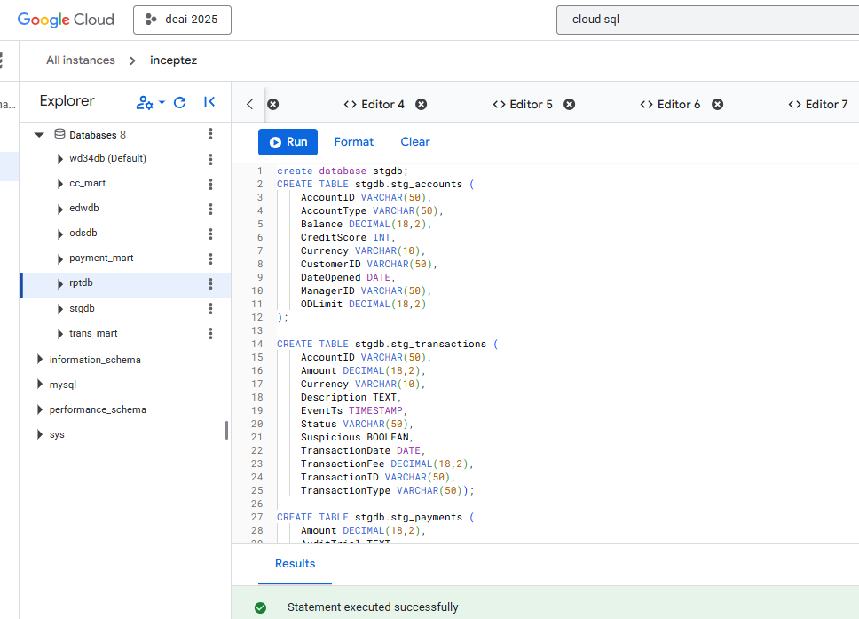
1. Staging Layer Load
Staging Layer
Source system pushed raw data to the Landing zone (CSV)
Load the filesystem data exactly as received with Minimal/No transformation into our DSA (staging) tables….
https://drive.google.com/drive/folders/1plrOpE5xz0iO4Mh9s0YO3kbeiJ-O-6Nr?usp=drive_link
Open the below sql file using a text editor, copy and run into the mysql db (workbench) to create the dbs+tables. (SQL - Declarative Language)
Run the below python code (cmd prompt) to load data from windows filesystem to the mysql stg table. (Python - Function Based Prog. Language)
Search -> cmd -> python
1.Platform Team/DBA/Lead/Dev (Only Once)
Datawarehouse
Dis-Integrated
Source
Systems
Landing
Pad
Staging
Layer (DSA)
Python
Files
S/SS
PUSH
Ingestion
Acquisition
Extracts
Inbound
SERVER
Files
STGDB
DBs
Raw Data
Truncate & load Table/
Filesystem (Landingpad)
Legacy Sys

Slide 29
2. ODS (Operational Data Store) Layer Load
Will hold few weeks to months of source data (cleansed + scrubbed) for reusability in case of need by the DWH, hence we don’t have to depend on the source system.
Cleaned & standardized data.
Removes duplicates & fixes formats
Standardizes units & codes
Integrates multiple sources.
Open the below sql file using a text editor, copy and run into the mysql db.
#Standardization/Munging
#cleansing - where AccountID is not null
#scrubbing - trim(AccountType), upper(currency)
#Enrichment - current_date load_dt, current_timestamp load_ts
Datawarehouse
Dis-Integrated
Source
Systems
Operation Data
Store (ODS)
Landing
Pad
Staging
Layer (DSA)
Python
SQL
ODS DB
Files
S/SS
PUSH
Ingestion
Acquisition
Extracts
Inbound
SERVER
Files
STGDB
Cleansing
Scrubbing
DBs
Raw Data
Truncate & load Table/
Filesystem (Landingpad)
ETL
Legacy Sys
Cleansed/Scrubbed
1 Month History Tables

Slide 30
3. EDW Layer Load
Facts – actual happenings/quantitative/transactions/events
Dimensions – Way of describing/viewing the facts/ Qualify facts in different dims.
What are the Way we receive data from source? Full or Delta/incremental
Way we load Dim tables ?
No history (Slowly changing Dimension Type1 (SCD1))
Maintain History + insert(modified + newly) (Slowly changing Dimension Type2 (SCD2))
5. Different Schema models available to relate fact & dim. – Star Schema & Snowflake Schema
EDW Layer
Central historical repository -Single source of truth.
Stores Dimensions (SCD1/SCD2) & Facts.
Applies business rules & derived metrics.
Open the below sql file using a text editor, copy and run into the mysql db.
Datawarehouse
Dis-Integrated
Source
Systems
Operation Data
Store (ODS)
Datawarehouse
Full/
Incremental
Staging
Layer (DSA)
Landing
Pad
Fact_loans Tables
Python
SQL
ODS DB
SQL
Files
S/SS
PUSH
Ingestion
Acquisition
Extracts
Inbound
SERVER
Files
STGDB
Cleansing
Scrubbing
Transformation
Business Logic
Dimension Tables
DBs
Raw Data
Truncate & load Table/
Filesystem (Landingpad)
ETL
ETL
Legacy Sys
Datawarehouse (edwdb)
Cleansed/Scrubbed
Tables
Transformed
Tables
Any users

Slide 31
What is Fact & Dimesions fundamentally
Facts – actual happenings/quantitative/transactions/events
Dimensions – Way of describing/viewing the facts/ Qualify facts in different dims.
What is Fact & Dimesions: (Transactions/Events)
Irfan is of 43 years age into IT profession is going to a ABC Super market in velachery and buying a product sugar for 100rs of 2 kgs
went by around 9AM and came out at 10AM 11/10/2025
2. Arun is of 53 years age into Govt profession is going to a ABC Super market in Guindy and buying a product sugarfree for 50rs of 1 box
went by around 9AM and came out at 10AM
Identify few things?
Where these transactions are generated? POS systems (OLTP - DBs)
Where these transactions are preserved for long time finally? DWH (Historical Analysis) & Marts
Two major form of tables in DWH? Facts & Dimensions
How to identify Fact? Actual happenings (values) – Quantifiable values
How to identify Dimensions? How to visualize the happenings (visibility of values) – Qualifiable values
What are the types of Dimension loading types are there? Actually 6 types are there, but 2 are very important
SCD Type0 – Static Data – calendar dimension
SCD Type1 – Don’t Maintain History in the Dimension table – day1(a,b,c), day2(x,b,c,d)
SCD Type2 – Maintain History (entire) in the Dimension table - day1(a,b,c), day2(a(INACTIVE),x(ACTIVE),b,c,d), day3(a(INACTIVE),x(INACTIVE),Y(ACTIVE),b,c,d)
SCD Type3 – Maintain History (only last 2) in the Dimension table - day1(a,b,c), day2(a(INACTIVE),x(ACTIVE),b,c,d,e), day3(x(INACTIVE),xx(ACTIVE),b,c,d,e)
Types of Dimension & Facts?
Fact_transactions:
Transid Amt quantity time customerid productid storeid txn_date
1 100 2 9.00 10 A s1 2025-10-05
2 50 1 9.00 11 B s2 2025-10-05
7. What are the Dimensions here?
Customer_Dimension:
Custid name age profession
10 Irfan 43 IT
11 Arun 53 Govt
Store_dimension:
Store_id storename location manager
S1 ABC store Velachery Girish
S2 ABC store Guindy Vaanmathy
Product_dimension:
Product_id productname
A sugar
B sugarfree Date/Calander Dimension (Static Data) -> SCD Type0 we use to load
Verifying whether Data model we created is perfect? By reproducing data in any way we needed..
Joining fact + customer dim?
Txid amt quantity time cid name age profession
1 100 2 9.00 10 Irfan 43 IT
Joining fact + store dim?
Txid amt quantity time sid sname location
1 100 2 9.00 s1 ABC velachery
Joining fact + customer + store dim?
Txid amt quantity time cid name age profession sid sname location
1 100 2 9.00 10 Irfan 43 IT s1 ABC velachery

Slide 32
3. EDW Layer Load
Facts – actual happenings/quantitative/transactions/events
Dimensions – Way of describing/viewing the facts/ Qualify facts in different dims.
What are the Way we receive data from source? Full or Delta/incremental
Way we load Dim tables ?
No history (Slowly changing Dimension Type1 (SCD1))
Maintain History + insert(modified + newly) (Slowly changing Dimension Type2 (SCD2))
5. Different Schema models available to relate fact & dim.
EDW Layer
Central historical repository -Single source of truth.
Stores Dimensions (SCD1/SCD2) & Facts.
Applies business rules & derived metrics.
Open the below sql file using a text editor, copy and run into the mysql db.
DataMart
Subject Oriented
Available
Specific
users
FinMart
Fin_fact
Datawarehouse
Gov Mart
gov_fact
Subject Area
Subset of DWH
HR Mart
Dis-Integrated
Source
Systems
Operation Data
Store (ODS)
Full/
Incremental
Staging
Layer (DSA)
Landing
Pad
Fact_loans Tables
ODS DB
SQL
SQL
Files
S/SS
Python
STGDB
SQL
PUSH
Ingestion
Acquisition
Extracts
Inbound
SERVER
Files
Cleansing
Scrubbing
Dimension Tables
Joins &
Business Logics
Transformation
Business Logic
DBs
Raw Data
Truncate & load Table/
Filesystem (Landingpad)
ETL
ETL
ETL
Legacy Sys
Datawarehouse (edwdb)
Cleansed/Scrubbed
Tables
Transformed
Tables
Any users

Slide 33
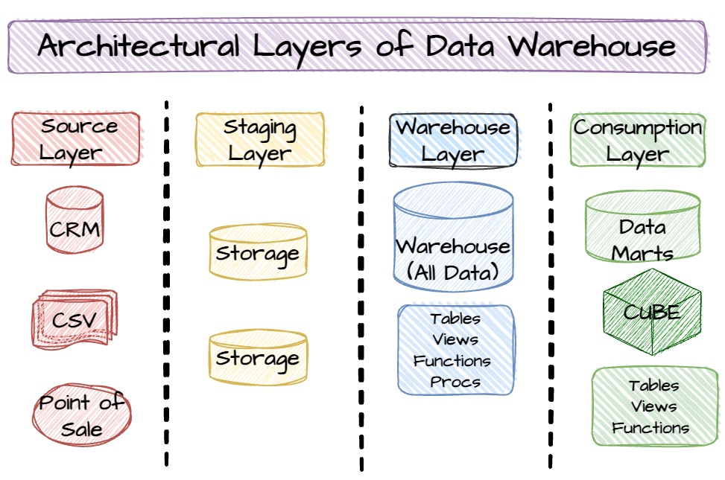
SCD Concepts
SCD - TYPE1 - Don’t maintain history
Source |  | DWH-Dim
full |  | trunc & load
incremental - inserted |  | just insert
incremental - inserted+updated |  | insert else update
STG |  |  |  | ODS - REPLACE |  |  |  |  | DWH custdim
05-10-2025 |  |  |  | 05-10-2025 |  |  |  |  | 05-10-2025
cid | cname | area |  | cid | cname | area |  |  | cid | cname | area
1 | irfan | velachery |  | 1 | Irfan | Velachery |  |  | 1 | Irfan | Velachery
2 | amar | parrys |  | 2 | Amar | Parrys |  |  | 2 | Amar | Parrys
SQL Sample:
create table odsdb.samplebranchsrc(id int,name varchar(100),city varchar(100));
#day1 - 2025-10-07
insert into odsdb.samplebranchsrc values(1,'x','chn'),(2,'y','mum');
select * from odsdb.samplebranchsrc;
create table edwdb.samplebranchtarget(id int,name varchar(100),city varchar(100),enddt date,activeflag varchar(1));
select * from edwdb.samplebranchtarget;
insert into edwdb.samplebranchtarget
select s.*,null,1
from odsdb.samplebranchsrc s
left join edwdb.samplebranchtarget t
on s.id=t.id and t.activeflag=1
where t.id is null
or s.name<>t.name
or s.city<>t.city;
#day2 2025-10-08
insert into odsdb.samplebranchsrc values(3,'z','chn');
SET SQL_SAFE_UPDATES = 0;
update odsdb.samplebranchsrc set city='blr' where id=1;
select * from odsdb.samplebranchsrc;
insert into edwdb.samplebranchtarget
select s.*,null,1
from odsdb.samplebranchsrc s
left join edwdb.samplebranchtarget t
on s.id=t.id and t.activeflag=1
where t.id is null
or s.name<>t.name
or s.city<>t.city;
select * from edwdb.samplebranchtarget;
update edwdb.samplebranchtarget t
left join odsdb.samplebranchsrc s
on s.id=t.id and t.activeflag = 1
set enddt=current_date - interval 1 day,activeflag=0
where t.id is not null
and (s.name<>t.name
or s.city<>t.city);
select * from edwdb.samplebranchtarget t
left join odsdb.samplebranchsrc s
on s.id=t.id and t.activeflag = 1
where t.id is not null
;
Truncate & Load
06-10-2025
cid | cname | area
1 | irfan | guindy | update
2 | amar | parrys | UNMODIFIED
3 | balaji | guindy | insert
4 | vivek | tambaram | insert
06-10-2025
cid | cname | area
1 | irfan | Velachery Guindy
2 | amar | parrys
3 | balaji | guindy
4 | vivek | tambaram
SCD Type1
Truncate & Load

Slide 34
SCD Concepts
SCD - TYPE2 - Maintain history
Source |  | DWH-Dim
full |  | trunc & load
incremental - inserted |  | just insert
incremental - inserted+updated |  | insert and update flag/date
Day1 08-10-2025 | odsdb.branch |  |  | etl (sql) |  |  |  |  | edwdb.branch |  | 08-10-2025
branchid | branchname | city |  | insert only |  |  |  | branchid | branchname | city | enddt | activeflag
1 | x | chn | Updated | maintain history |  |  |  | 1 | x | chn | null | 1
2 | y | mum |  |  |  |  |  | 2 | y | mum | null | 1
Inserted
Inserted
Updated
Day2 09-10-2025 | odsdb.branch |  |  | etl (sql) |  |  |  |  | edwdb.branch |  | 09-10-2025
branchid | branchname | city |  | insert only |  |  |  | branchid | branchname | city | enddt | activeflag
1 | x | Chn -> Blr | Updated | maintain history |  |  |  | 1 | x | chn | 08-10-2025 | 0
2 | y | mum |  |  |  |  |  | 2 | y | mum | null | 1
3 | z | chn | Inserted |  |  |  |  | 1 | x | Blr | null | 1
 |  |  |  |  |  |  |  | 3 | z | chn | null | 1
Inserted
Inserted

Slide 35
4 - SCD Concepts
 |  |  | SCDTYPE2
 | day1 |  |  | day1
 | 1 | a |  | 1 | a
 | 2 | b |  | 2 | b
day2 |  |  |  | day1+2 |  |  | VERSION | EFFECTIVE DATE | ACTIVE_FLAG
1 | X | UPDATED |  | 1 | a | UNCHANGED | 1 | 10-10-2025 | N
2 | b | UNCHANGED |  | 2 | b | NOTHING HAPPENS | 1 | 10-10-2025 | Y
3 | c | INSERTED |  | 1 | X | INSERTED | 2 | 10-11-2025 | Y
 |  |  |  | 3 | c | INSERTED | 1 | 10-11-2025 | Y
 |  | SCDTYPE0
day1 |  |  | day100
1 | a |  | 1 | a
2 | b |  | 2 | b
 |  | SCDTYPE1
day1 |  |  | day1
1 | a |  | 1 | a
2 | b |  | 2 | b
 |  |  | SCDTYPE3
 | day1 |  |  | day1
 | 1 | a |  | 1 | a
 | 2 | b |  | 2 | b
day2 |  |  |  | day1+2 |  |  | ACTIVE_FLAG
1 | X | UPDATED |  | 1 | a | UNCHANGED | N
2 | b | UNCHANGED |  | 2 | b | NOTHING HAPPENS | Y
3 | c | INSERTED |  | 1 | X | INSERTED | Y
 |  |  |  | 3 | c | INSERTED | Y
day3 |  |  |  | day1+2 |  |  | ACTIVE_FLAG
1 | y | UPDATED |  | 2 | b | NOTHING HAPPENS | Y
2 | b | UNCHANGED |  | 1 | X | INSERTED | N
3 | c | UNCHANGED |  | 3 | c | INSERTED | Y
4 | d | INSERTED |  | 1 | y | INSERTED | Y
 |  |  |  | 4 | d | INSERTED | Y
day2 |  |  | day1+2
1 | X |  | 1 | X
2 | b |  | 2 | b
Farook - Dim tables in DWDB will have all the data that we need.
For what reason do we link the tables from ODSDB with fact tables?

Slide 36
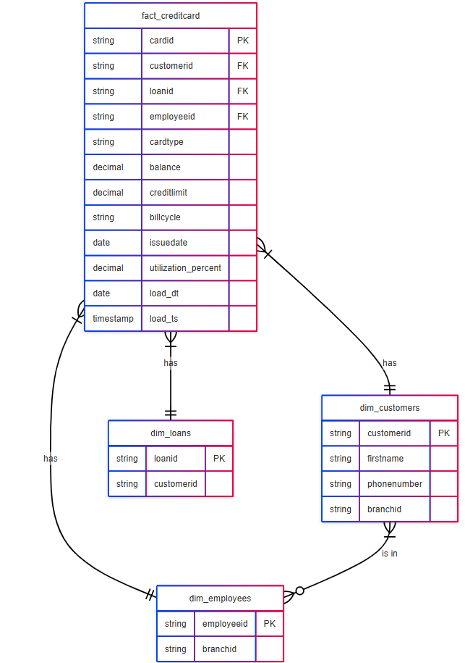
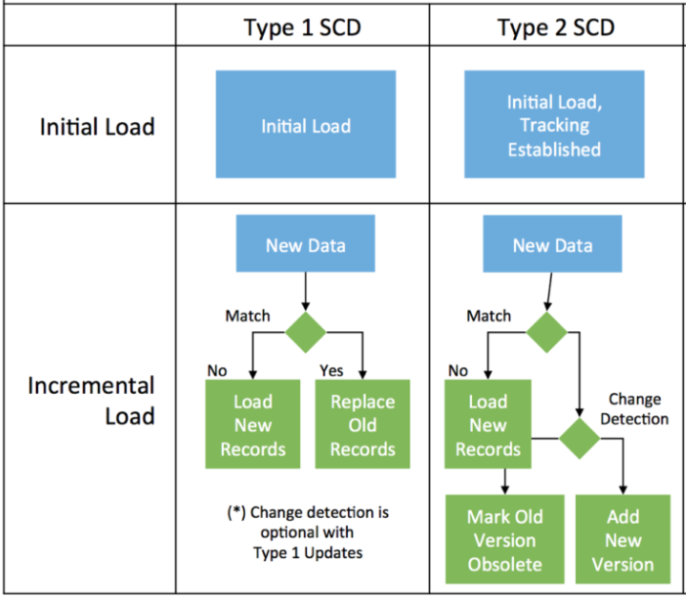
3. EDW Layer Load
EDW Layer
Central historical repository -Single source of truth.
Stores Dimensions (SCD1/SCD2) & Facts.
Applies business rules & derived metrics.
Open the below sql file using a text editor, copy and run into the mysql db.

Slide 37
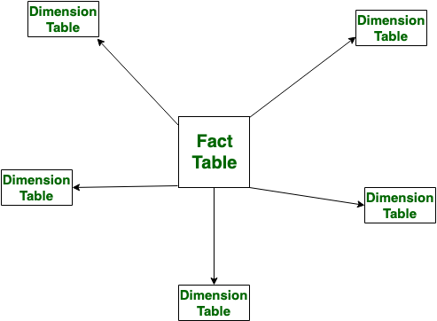
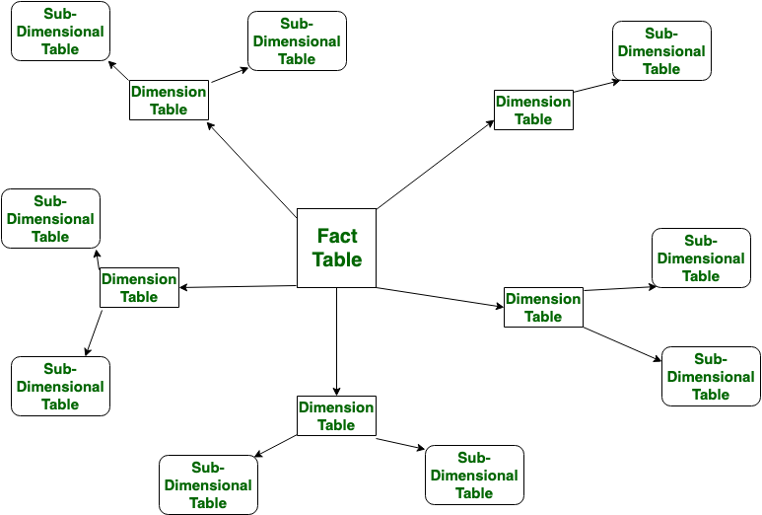
3. Mart Load
Star Schema
Data Marts
Subject-specific dataset with the respective facts
Improves performance.
Department-focused views.
Snowflake Schema

Slide 38
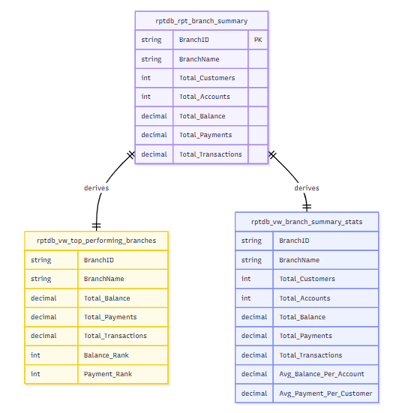
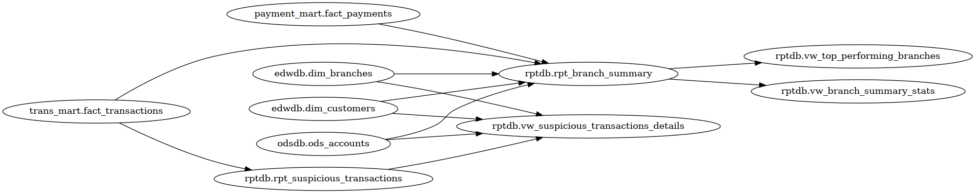
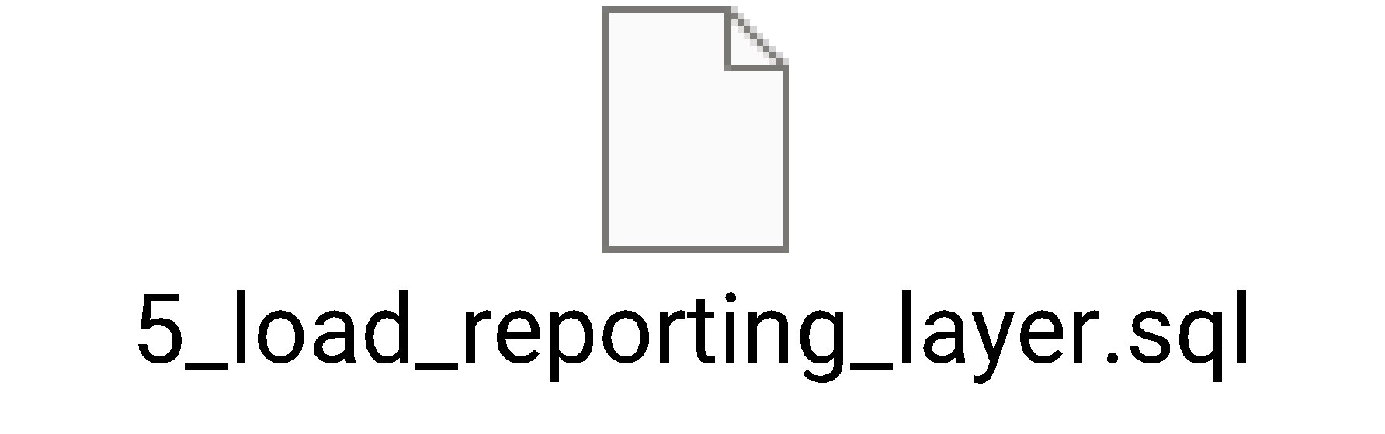
Reporting Layer Load
Reporting Layer
Presentation-ready data. - Pre-aggregated & formatted. - Supports dashboards & BI tools. - Applies security filters.

Slide 39
What we learned in the Stage1 ?
Functionally/Business Terminologies
ETL, EL
BFSI
Data modeling
Data Flow Diagram
Customer Risk aggregation
ER Diagram ()
Roles of different personas –
SINTA
…
Technically (Terminologies)
Truncate & Load
Incremental Refresh
……

